Slide 1
Olympia dictionary
Sergii Opryshko 7759145 sopryshko9145@conestogac.on.ca
Brahmpreet Singh 7845159 brahmpreet.official@gmail.com
Sharfaraz Ahamed Bachinvalapan Hameed 7834120 sharfrazq17@gmail.com
Anju Mathew 7804396 10mathew10@gmail.com
Ω

Slide 2
Problem statement
More than 1 billion people are learning English worldwide
750 million use English as a Foreign Language speakers (British Council 2000)
No single app that allows the users to manipulate the words they search for
SOLUTION
A smartphone application that uses public APIs of popular dictionaries and allows the users to manipulate the words they search for
Ω

Slide 3
Mission and Vision
MISSION – Give people the possibility to learn English language faster and more efficiently with the help of modern technologies
VISION – Every person on Earth can speak English as good as their native language
Ω

Slide 4

Introduction
Ω

Slide 5
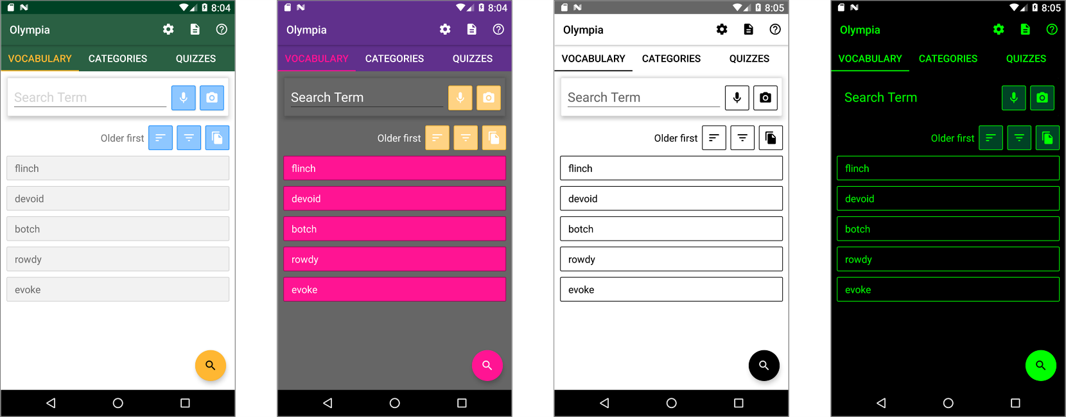
Key Features 1/2
Put words in categories
Self checking tests (quizzes) and statistics
Multiple languages support
Personalized and customizable – theme support:
Ω

Slide 6
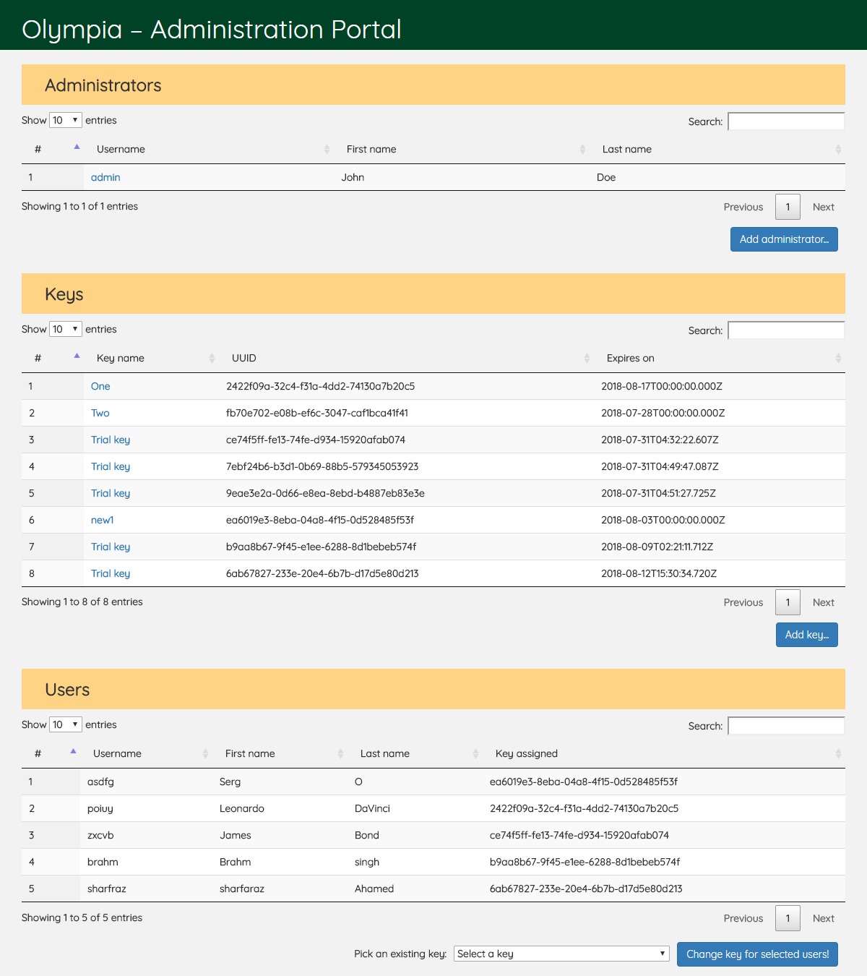
Key Features 2/2
Accessibility features OCR, TTS, STT, font size
Social network support
Administration panel:
Ω

Slide 7
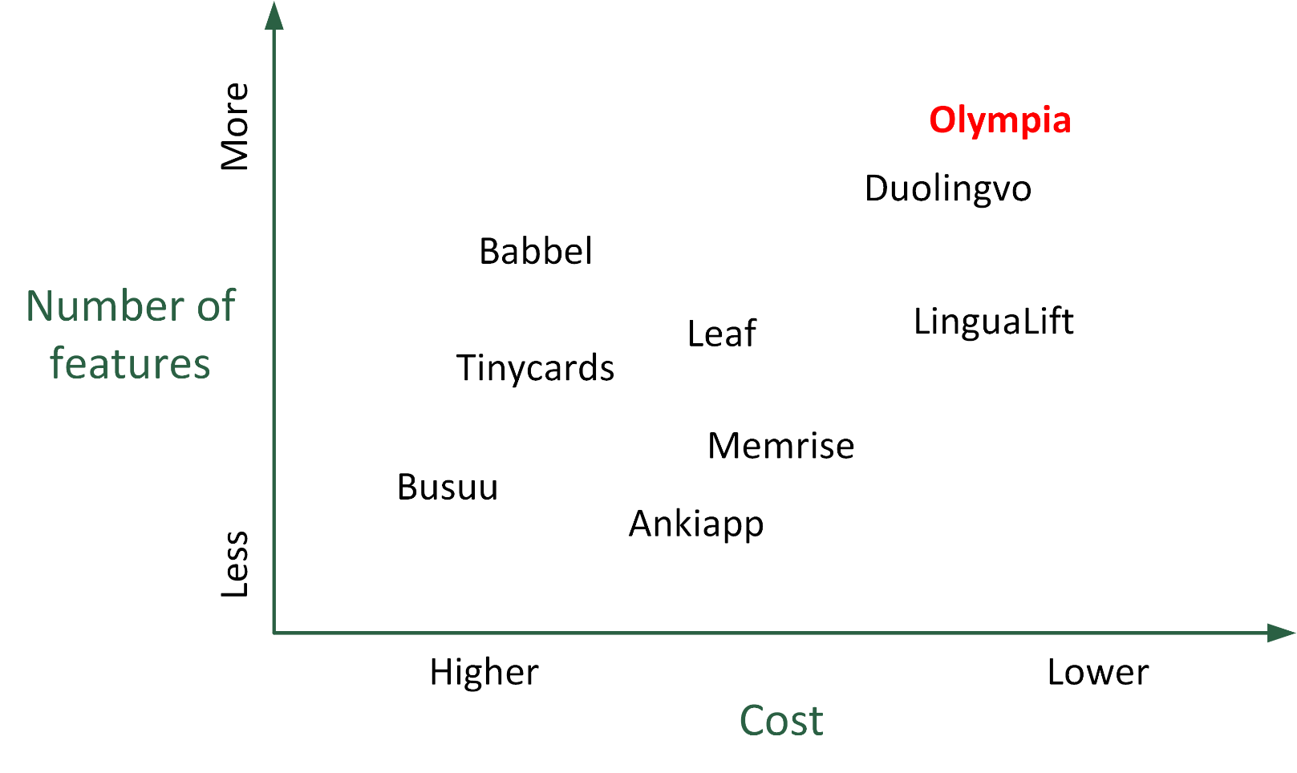
Competition
Ω

Slide 8
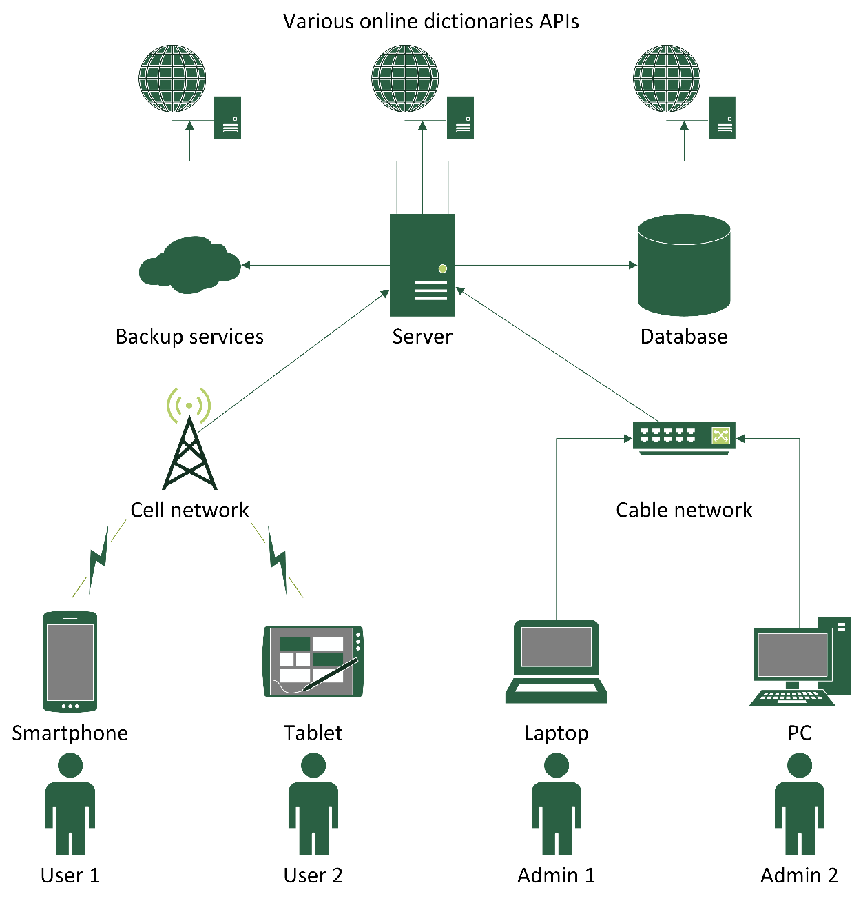
High level design
SaaS
Client-server
RESTful APIs
Third party cloud backup
Ω
Notes:
The system is built in a classical client-server architecture and uses software as a service model to allow easier maintenance and high security for our customers. In most network interactions RESTful APIs are used. The server uses a database for user profiles and a cloud backup.

Slide 9





Architecture
Development plan
Third party APIs used
Retrofit
ReactiveX
Room
Tesseract Tools
Transitions everywhere
Datatables
Challenges
User testing
Ω
Notes:
The project was developed in two week sprints and actively uses a number of third party libraries for network requests, database and UI. Among the challenges is working in an event-driven environment. User testing was conducted on a small number of our friends and relatives.

Slide 10
Future goals
IOS app/Windows app
More dictionaries & UI languages support
Cloud synchronisation of vocabulary
Integration with browsers and book readers
Premium packages
Blog
Social media pages
SEO and App Store marketing
Update business plan & financial projection
Update terms & conditions
Decide on new features to be implemented
Look for strategic partnership with a coupon firm
Enhance in-app social interaction
Increase brand awareness
Improve customer experience
Ω

Slide 11
Questions?
Thank you!
☺
Ω

